Slide 1
Unit 5
Templates
Total Lecturer Hour:[5hrs]
Prepared by
Er.Harendra Bikram Shah
Lecturer
Department of Computer Engineering
NAST,Dhangadhi

Slide 2
OUTLINES
Introduction to Generic Programming
Introduction to Templates in C++
Types of Templates
STL[Standard Template Library]: Container, Algorithm and Iterator

Slide 3
Introduction to Generic Programming
Generics is the idea to allow type different data types to be a parameter to methods, classes and interfaces.
Generics are a way to write code that can be used with different data types without having to rewrite the same logic for each type.
In C++, They are achieved by using templates.
Two types of generics :
Generic Function: used for functions
Generic Class: used for Class
Generic programming is a programming way to focus on writing code in a way that maximizes code reuse through the use of generics.
Generic Programming enables the programmer to write a general algorithm which will work with all data types
The idea is to create algorithms and data structures that can operate on different types.
The advantages of Generic Programming
Code Reusability
Avoid Function Overloading
Write Once , use for multiple times and cases.

Slide 4
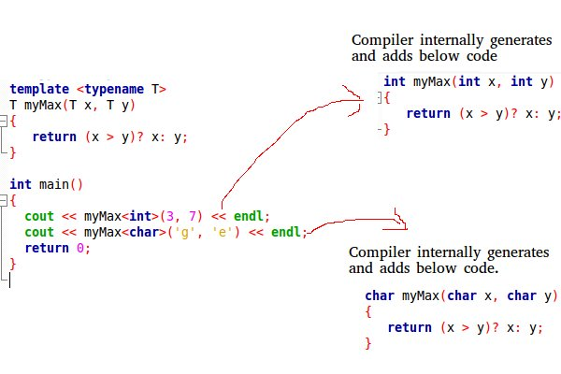
Introduction to Template
Templates are frame which allows to write generics in c++.
Templates helps to draw out any logic in c++
Template creates appropriate code at the time of execution.
Two types of Templates :Function and Class templates

Slide 5
FUNCTION TEMPLATE
Function template is used to create the family of function with different argument type.
It helps us to work with any data type in function in c++
Syntax:
template<class T>
Return type functionname(argument list of type class T)
{
Body of function;
}
Example:
Template <class T>
void add(T a ,T b)
{
T sum;
Sum =a+b;
}
Used in case of swapping ,sorting of array ,max ,min.

Slide 6
#include<iostream>
using namespace std;
template <class T>
T swap(T a,T b)
{
cout<<"before swapping :"<<"\n"<<"a:"<<a<<"\n"<<"b:"<<b<<endl;
T temp;
temp=a;
a=b;
b=temp;
cout<<"After swapping :"<<"\n"<<"a:"<<a<<"\n"<<"b:"<<b<<endl;
}
int main()
{
swap(4,5);
return 0;
}

Slide 7
FUNCTION TEMPLATE with multiple parameter
Syntax:
template<class T1,class T2,….>
Return type functionname(argument list of type T1,T2,….)
{
Body of function;
}
Example:
Template <class T1,class T2>
void add(T1 a ,T2 b)
{
T1 sum;
Sum =a+b;
}

Slide 8
#include<iostream>
using namespace std;
template <class t1,class t2>
void display(t1 a,t2 b)
{
cout<<a<<endl;
cout<<b<<endl;
}
int main()
{
display(1,2.5);
return 0;
}

Slide 9
Overloading FUNCTION TEMPLATE
Syntax:
template<class T1>
Return type functionname(argument list of type T1)
{
Body of function;
}
template<class T1, class T2>
Return type functionname(argument list of type T1,T2)
{
Body of function;
}
template<class T1, class T2,class T3,..>
Return type functionname(argument list of type T1,T2,T3,..)
{
Body of function;
}

Slide 10
#include<iostream>
using namespace std;
template <class t1,class t2>
void display(t1 a,t2 b)
{
cout<<a<<endl;
cout<<b<<endl;
}
template <class t1>
void display(t1 a)
{
cout<<a<<endl;
}
template <class t1,class t2,class t3>
void display(t1 a,t2 b,t3 c)
{
cout<<a<<endl;
cout<<b<<endl;
cout<<c<<endl;
}
int main()
{
display(1,2.5);
display("NAST");
display(2,4.5,"NAST");
return 0;
}

Slide 11
CLASS TEMPLATE
Class template is used to create the family of class with anonymous type.
It helps us to create any type of generic class in c++
Syntax:
template<class T>
class ClassName
{
//class member variables and functions with T
};
member function syntax:
Type member functionname(type argument)
{
//body
}
Creating a Class Template Object
className<dataType> classObject;
Example:
Add<int>obj(4,5);

Slide 12
#include<iostream>
using namespace std;
template <class T>
class demo
{
T a;
public:
void add(T x)
{
a=x;
}
void show()
{
cout<<"A="<<a<<endl;
}
};
int main()
{
demo<int>d;
d.add(4);
d.show();
return 0;
}

Slide 13
CLASS TEMPLATE with multiple parameter
Syntax:
template<class T1, class T2>
class ClassName
{
//class member variables and functions with T
};
member function syntax:
Type member functionname(type argument)
{
//body
}

Slide 14
#include<iostream>
using namespace std;
template <class T,class t1>
class demo
{
T a;
t1 b;
public:
add(T x,t1 y)
{
a=x;
b=y;
}
void show ()
{
cout<<"A="<<a<<endl;
cout<<"B="<<b<<endl;
}
};
int main()
{
demo<int,float>d;
d.add(4,4.5);
d.show();
return 0;}

Slide 15
CLASS TEMPLATE with Default data Types
Syntax:
template<class T1=int, class T2=char>
class ClassName
{
//class member variables and functions with T
};
member function syntax:
Type member functionname(type argument)
{
//body
}

Slide 16
#include<iostream>
using namespace std;
template <class T=int,class t1=char>
class demo
{
T a;t1 b;
public:
add(T x,t1 y)
{
a=x;
b=y;
}
void show()
{
cout<<"A="<<a<<endl;
cout<<"B="<<b<<endl;
}
};
int main()
{
demo<>d;
d.add(4,'n');
d.show();
return 0;
}

Slide 17
Standard Template Library
STL is a collection of algorithms, data structures, and other components that can be used to simplify the development of C++ programs.
Alexander Stepanov in 1994 invented STL
The STL requires the knowledge of template.
Features/Advantages of STL:
Time saving
Less efforts
Load fast
High quality programming
Code reusability
C++ STL has 3 major components:
Containers: Stores data and organize them in a specific manner as required. Ex: Array, queue, List etc.
Iterators: iterators are objects that are used to access elements of a container.
Algorithms: series of instructions to process the data in container. Searching, sorting, merging, copying, counting

Slide 18
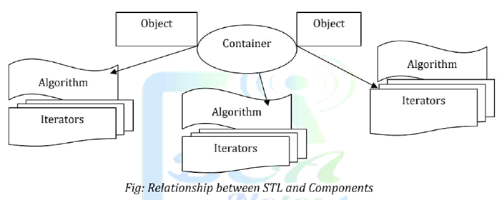
Standard Template Library COMPONENTS

Slide 19
Class Work
1) Write a program to create template to swap two integer and two string values.
2) WAP to design Simple Calculator Using Class Templates

Slide 20
Assignment Questions from this UNIT
Define term generic .Explain function template and Class Template?
Demonstrate the Function template to swap the value of two variables in c++.Why do we need template in c++.
Define STL in detail. Why do we need it ?. Explain Generic class by taking appropriate example.

Slide 21
END of THE UNIT 5

Slide 22
THANK YOU

